Slide 1


Journalism Innovation
@PaulBradshaw
#bcujournos

Slide 2
What you’ll find out:
What the next 11 weeks will involve
What you’ll be assessed on
And first, what the ‘innovation’ is…

Slide 3
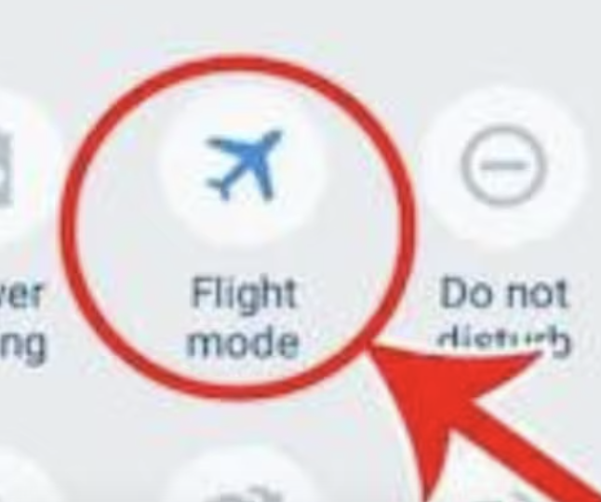
First: switch to flight mode

Slide 4


Slide 5
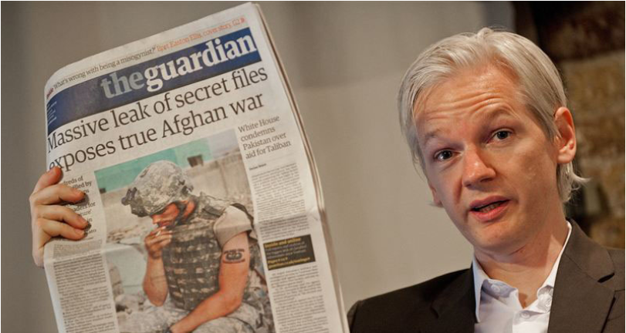
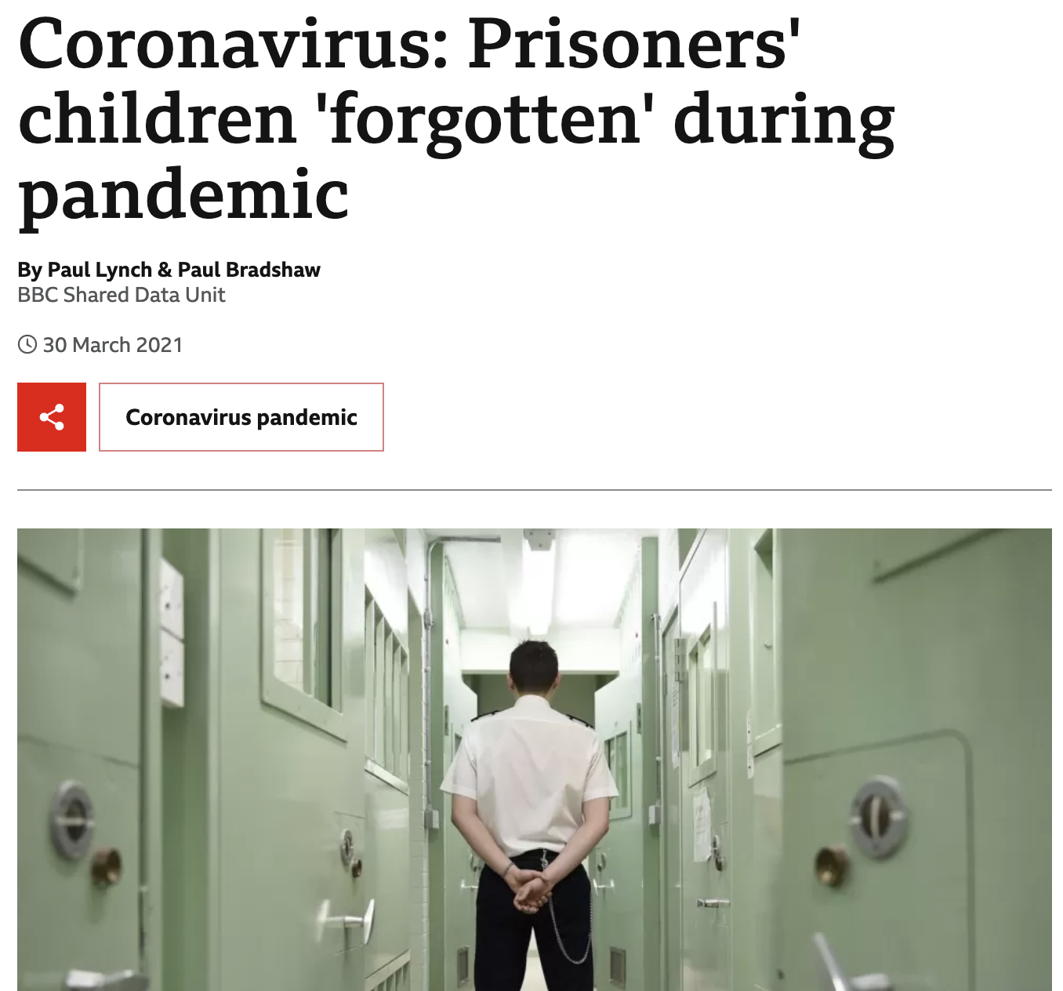
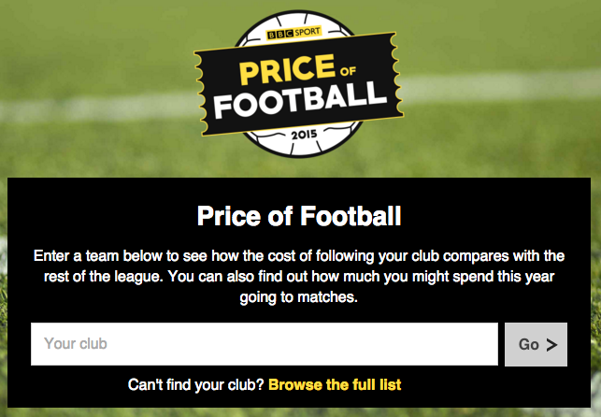
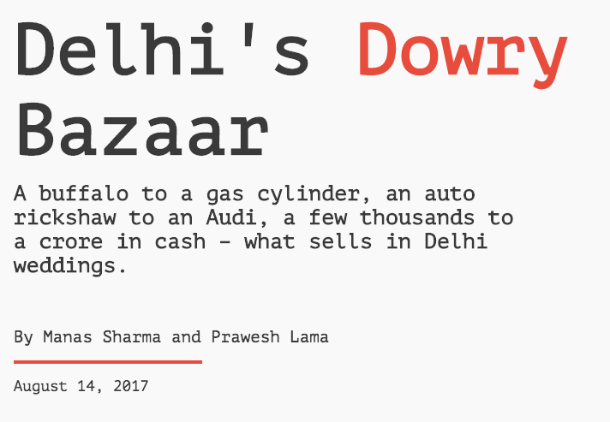
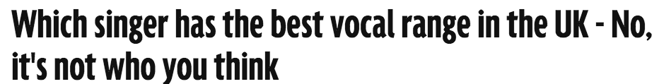

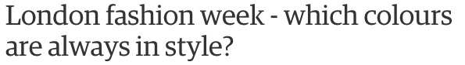
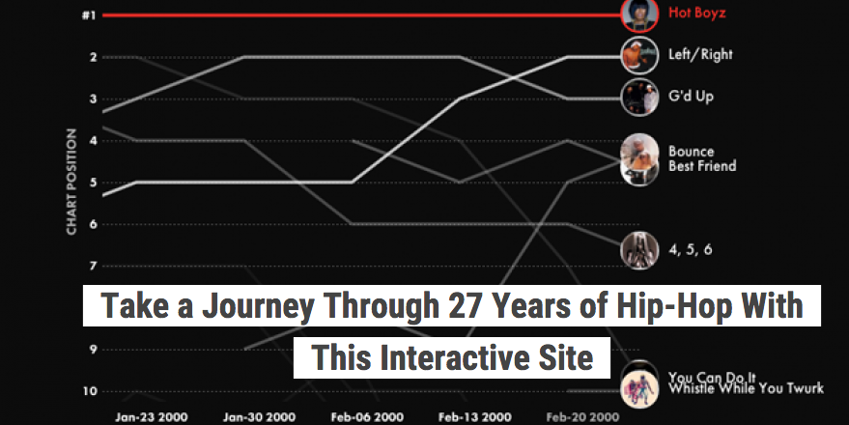
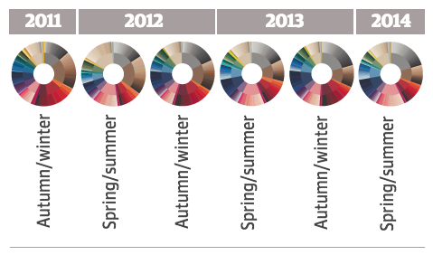

Slide 6
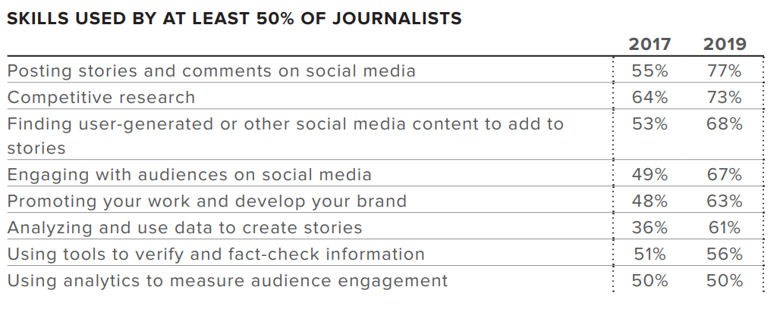
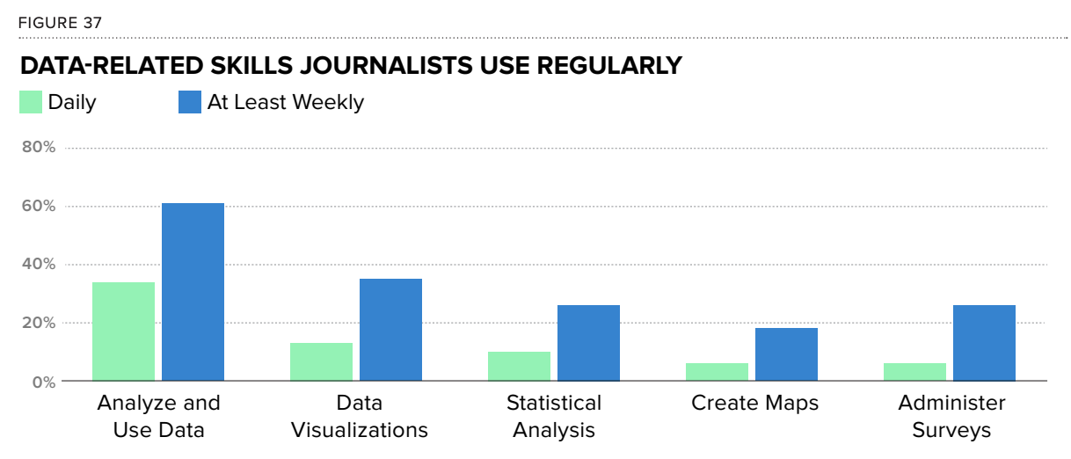
https://www.icfj.org/sites/default/files/2019-10/2019%20Final%20Report.pdf
https://newslab.withgoogle.com/assets/docs/data-journalism-in-2017.pdf

Slide 7
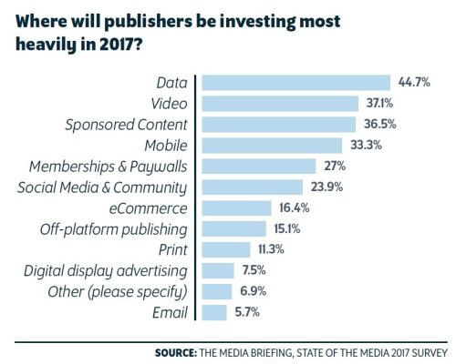
https://twitter.com/mediavoicespod/status/800673364935262208

Slide 8
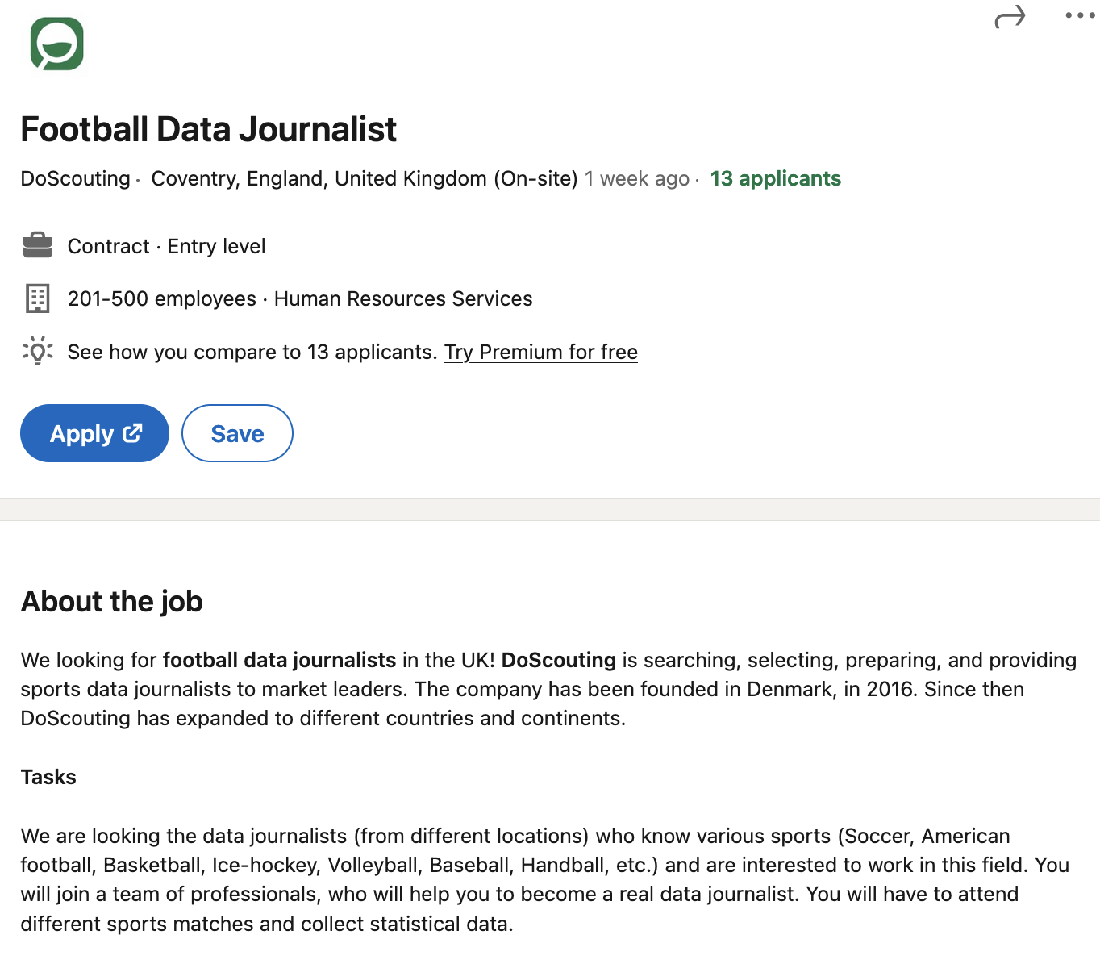
https://www.linkedin.com/jobs/view/3234512649/

Slide 9
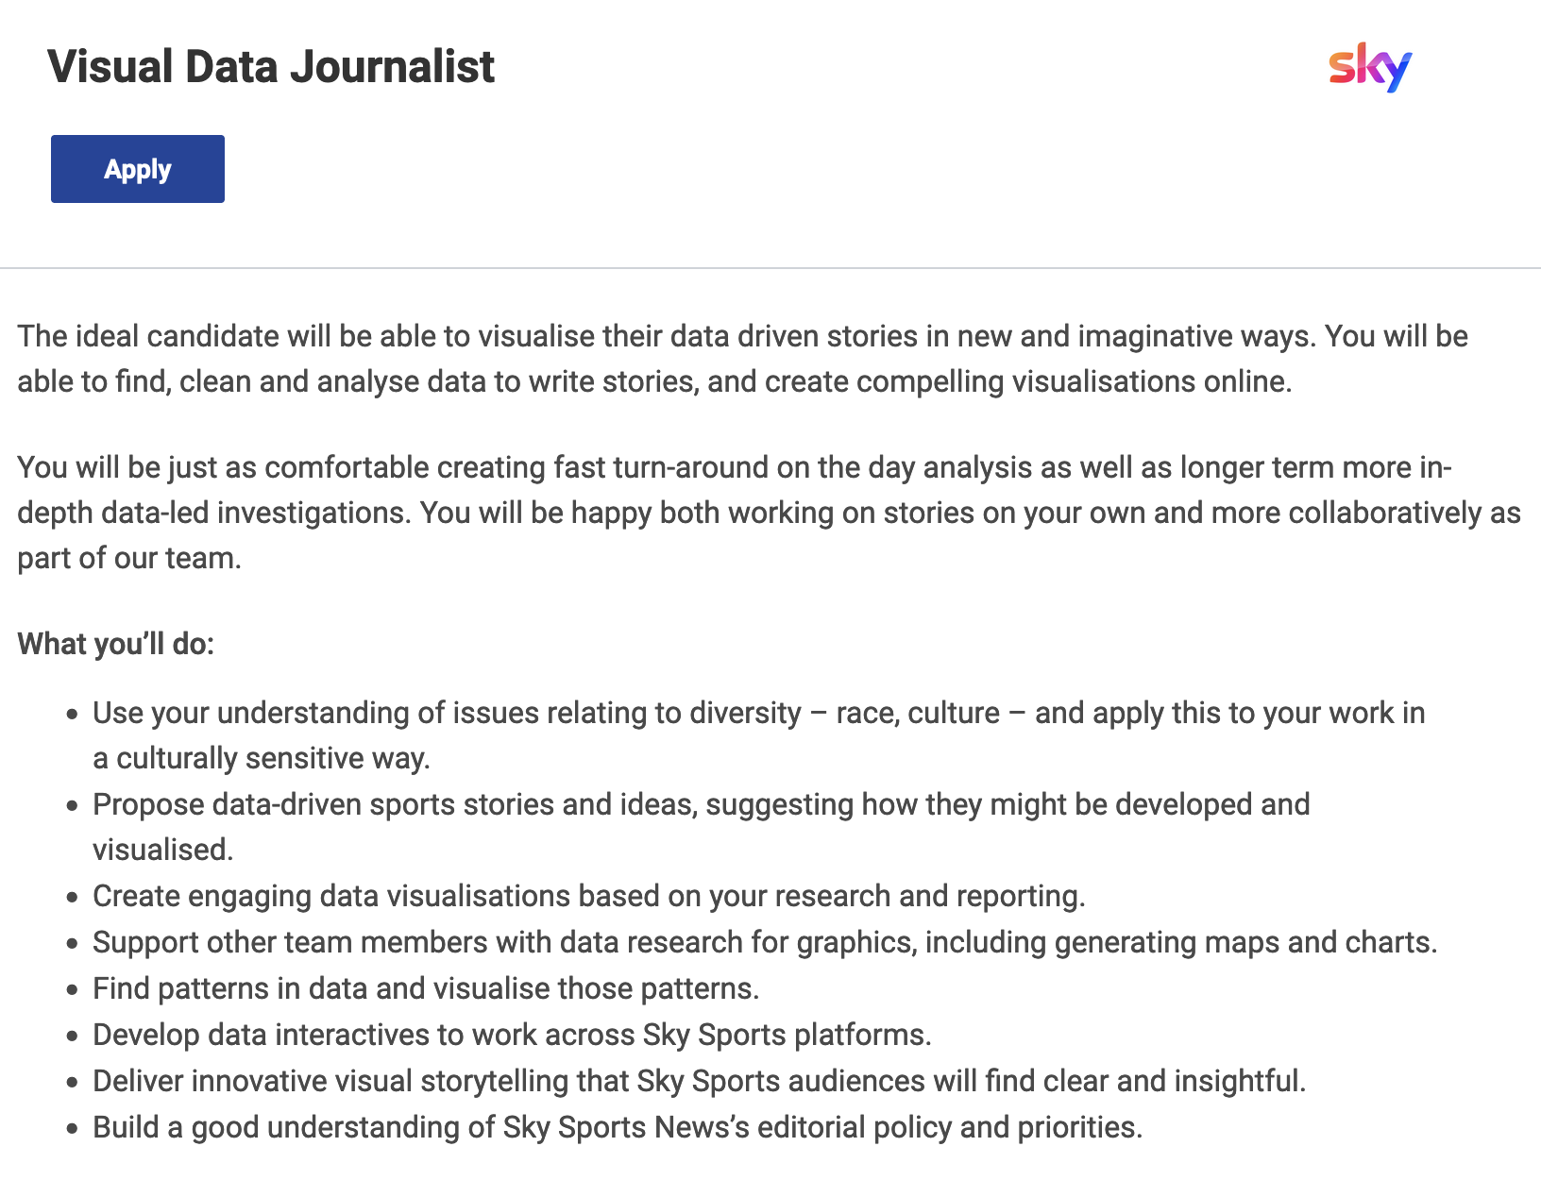
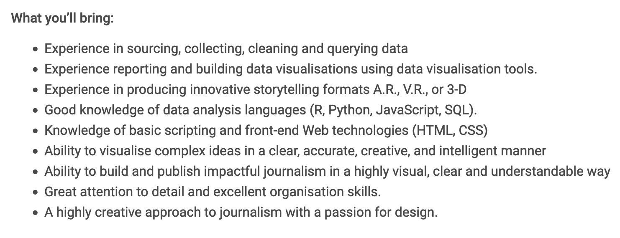
https://sky.wd3.myworkdayjobs.com/en-US/sky_careers/job/Visual-Data-Journalist_R0009385-1

Slide 10
“The BBC has a plan to develop data journalism as a cornerstone of its reporting and analysis in all areas of News coverage.”
BBC

Slide 11
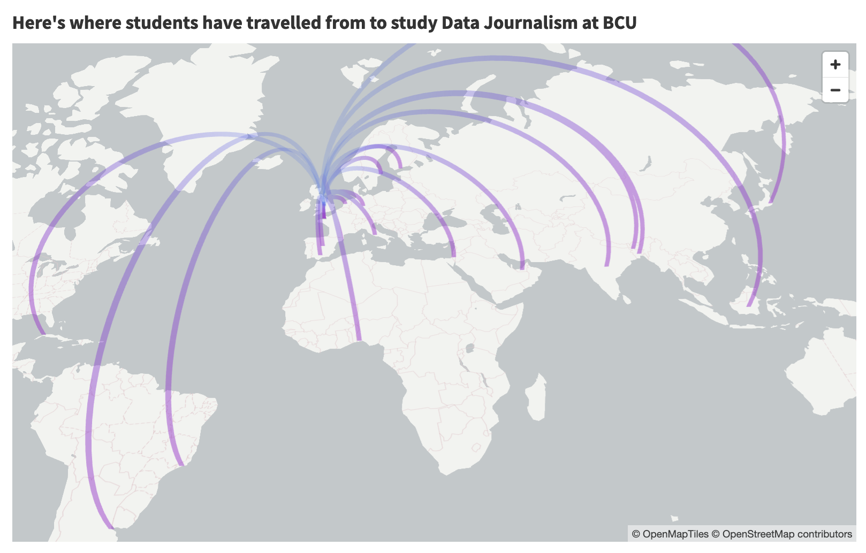
https://public.flourish.studio/visualisation/11177489/

Slide 12
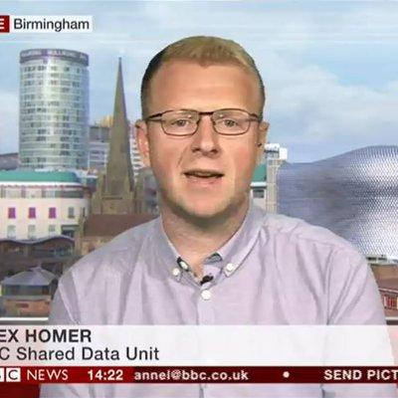
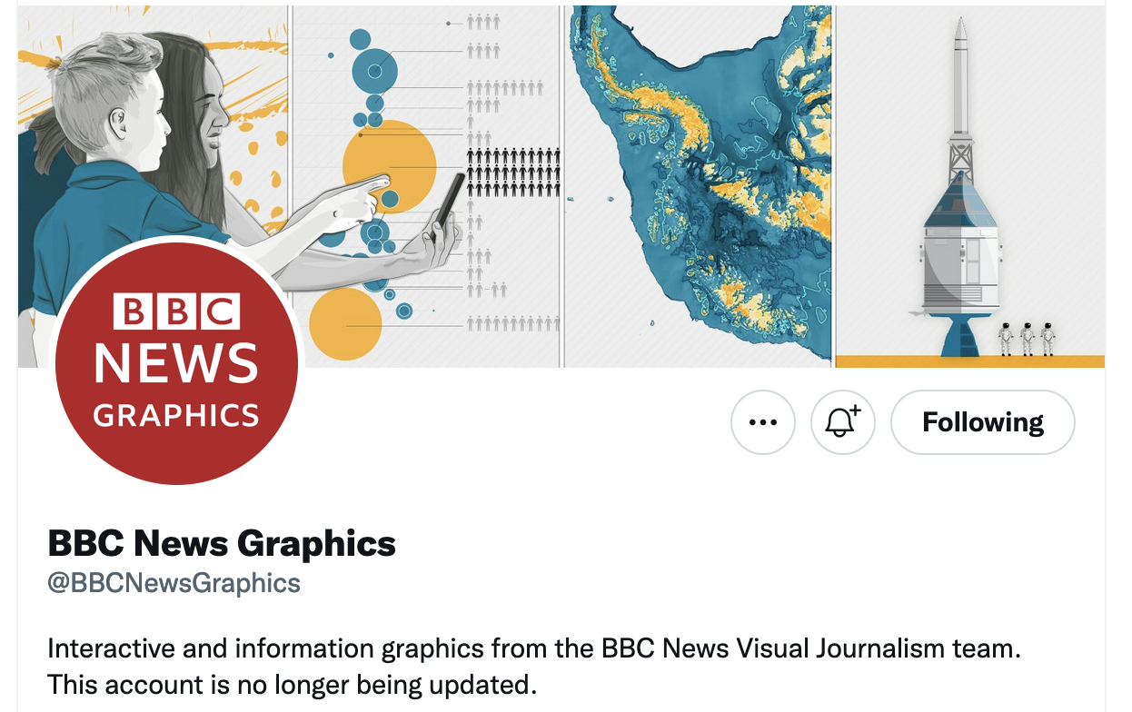
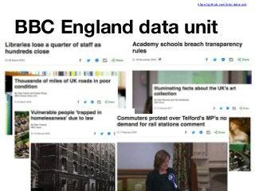
Birmingham: THREE data teams

Slide 13













Students now work at…

Slide 14
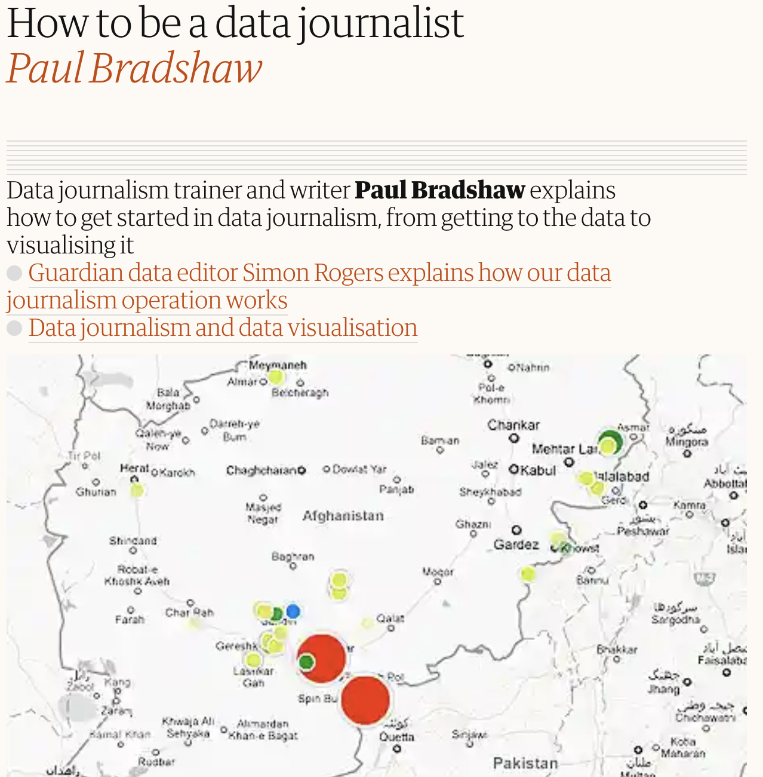
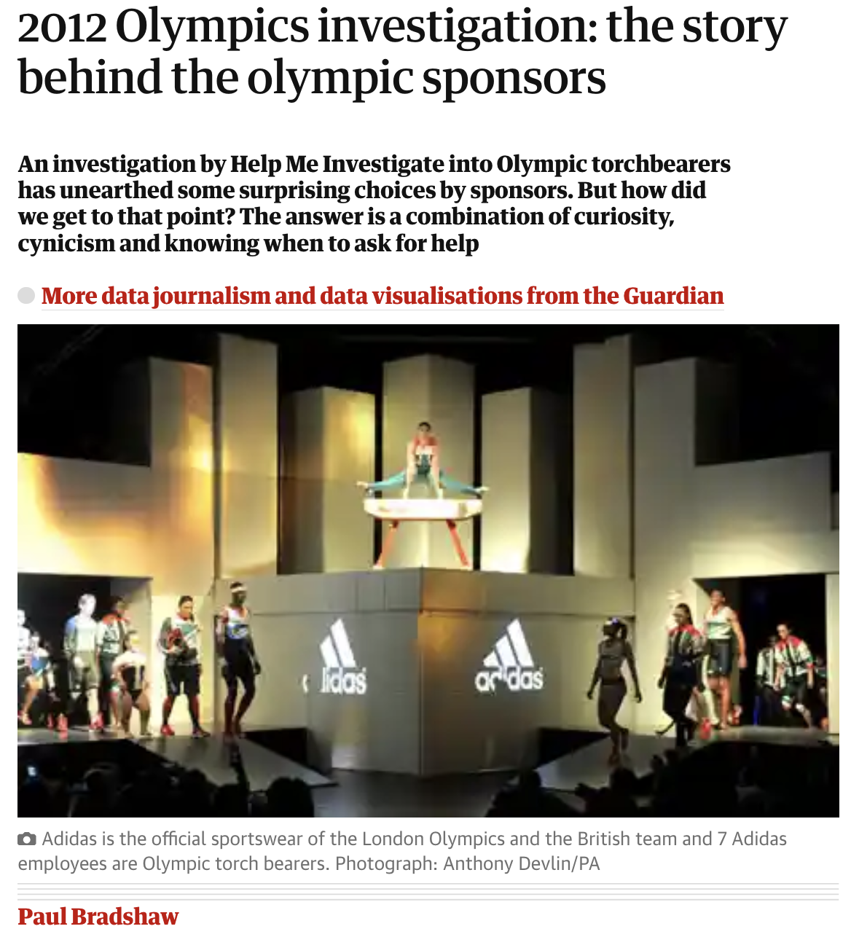
https://www.theguardian.com/news/datablog/2010/oct/01/data-journalism-how-to-guide
https://www.theguardian.com/news/datablog/2012/jun/06/olympics-2012-investigation

Slide 15
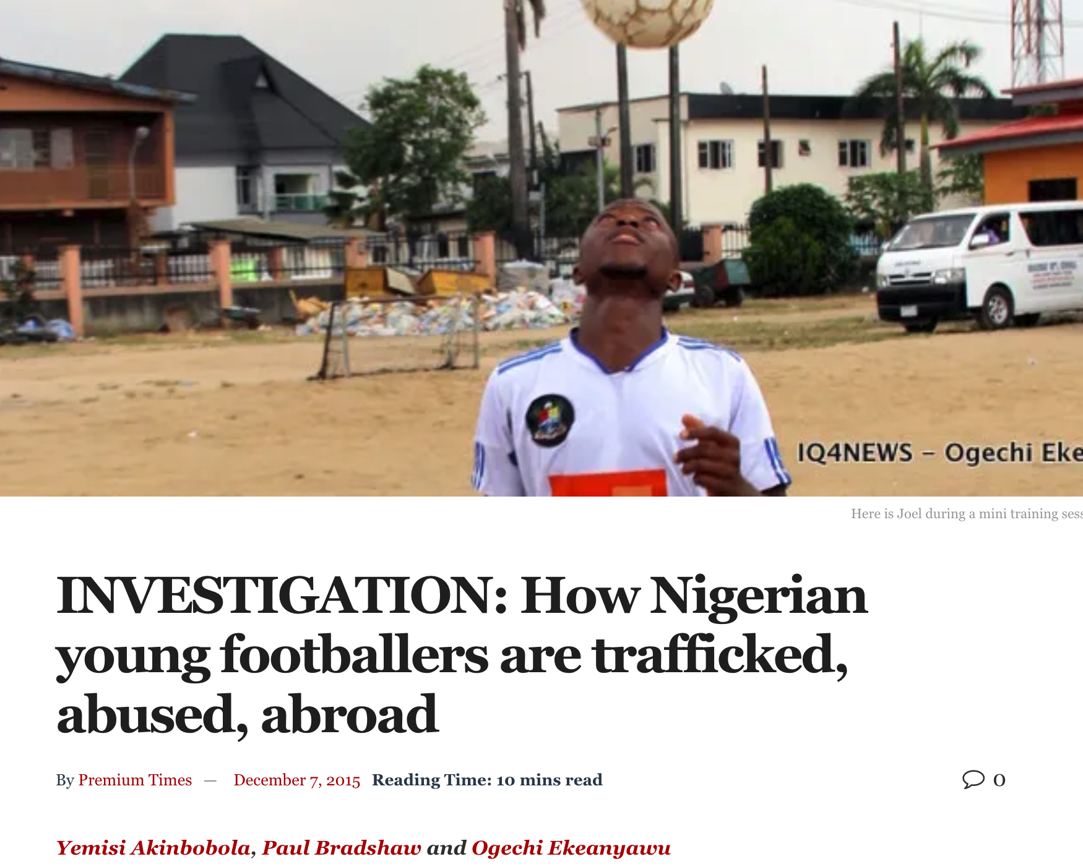
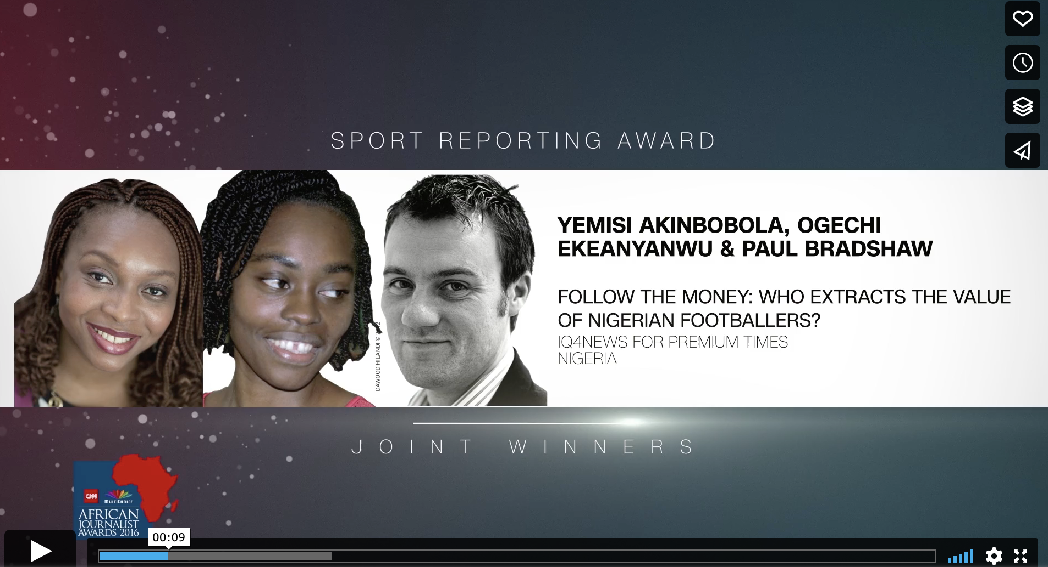
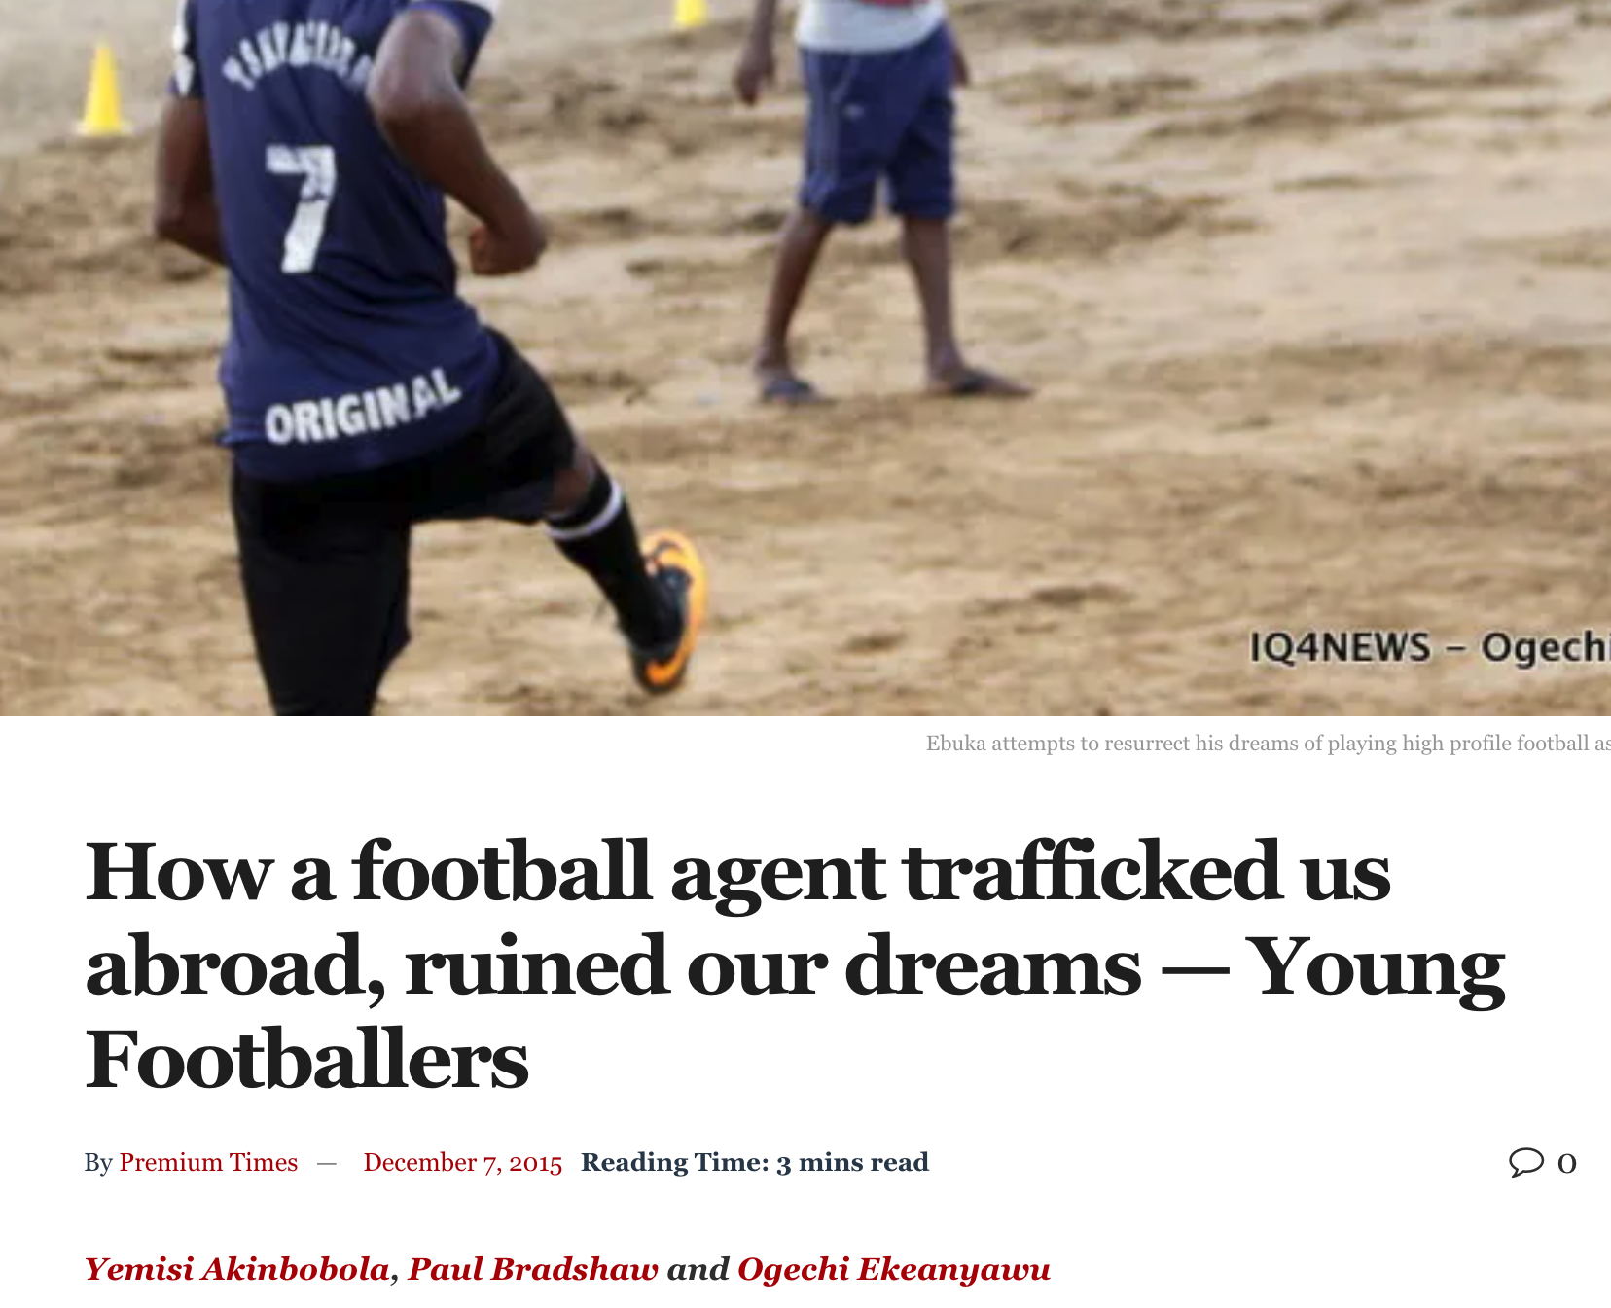

https://www.premiumtimesng.com/news/194420-investigation-how-nigerian-young-footballers-are-trafficked-abused-abroad.html?tztc=1 https://www.premiumtimesng.com/sports/194447-how-a-football-agent-trafficked-us-abroad-ruined-our-dreams-young-footballers.html https://vimeo.com/187993647

Slide 16
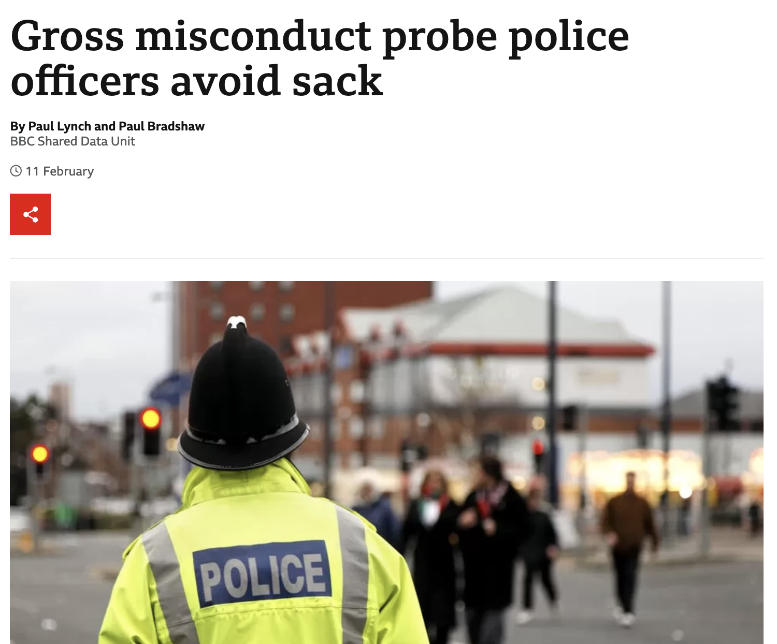
https://www.bbc.co.uk/news/uk-56420186 https://www.bbc.co.uk/news/uk-59594712

Slide 17
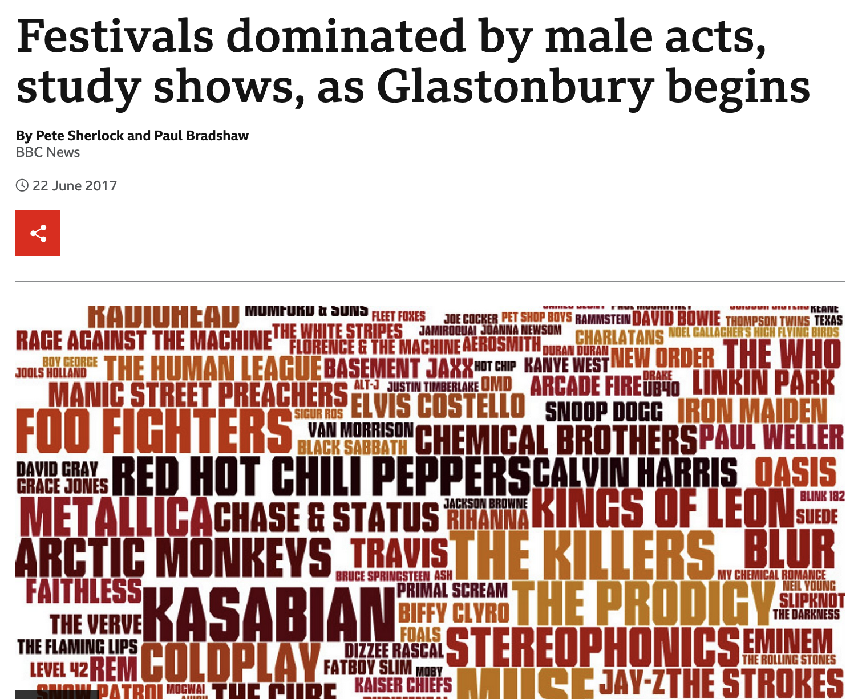
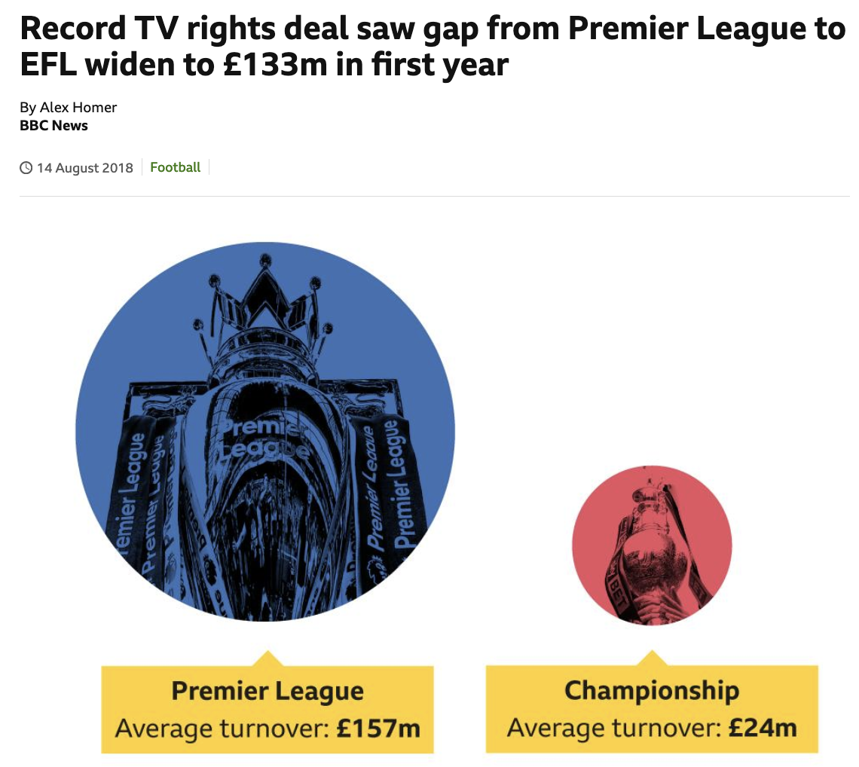
https://www.bbc.co.uk/news/uk-england-40273193
https://www.bbc.co.uk/sport/football/44981103

Slide 18
https://vimeo.com/187993647

Slide 19
The next 11 weeks
Introductions, assessment — and how to pass
How to find and pitch stories
Data visualisation and mapping
Using FOI
Getting stories out of data
Formats and writing

Slide 20
First — fill out this questionnaire! (on Moodle)
forms.office.com/e/VwEJJT8Q0t

